Slide 1

Home Credit
Default Risk Prediction
Top 10% Kaggle Solution with Pseudo-Labeling
AUC 0.804+ | 1000+ Features | 500K+ Training Samples

Slide 2
Technical Breakthroughs
0.804
01
Project Overview
02
Pseudo-Labeling Innovation
AUC Score
03
Risk Grouping Strategy
04
Feature Engineering
Top 10% Competition Rank
05
Model Performance
06
Future Directions

Slide 3


Team Division
Sida Lin:
Led pipeline development and model implementation.
Junqi Zhu:
Served as our feature engineering expert.
Jiachen Zhou:
Managed technical documentation and presentation coordination.
01
02
03

Slide 4
Project Overview & Key Achievements
Project Background
Key Performance Metrics
This project addresses the Kaggle Home Credit Default Risk competition, aiming to predict customer loan default probability and provide accurate risk control solutions for financial institutions.
0.804+
1000+
AUC Score
Features
500K+
Top 10%
Training Samples
Competition Rank
Core Technical Strategy
LightGBM + 5-fold Cross-Validation
Pseudo-labeling for Training Set Expansion
Achieved major breakthrough in default risk identification through multi-table aggregation and pseudo-labeling innovation.
Deep Feature Engineering (1000+ Features)

Slide 5
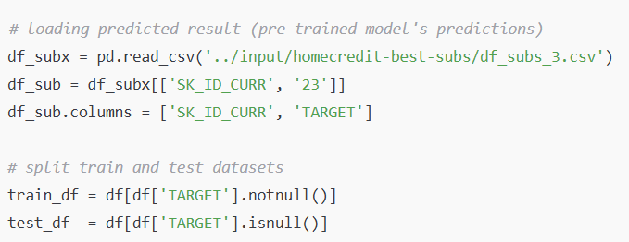
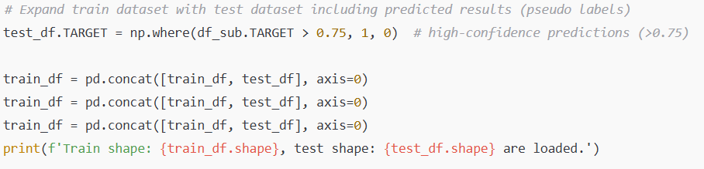
Pseudo-Labeling: Key Innovation
Technical Principle
Use a pre-trained model to predict on the test set, treating high-confidence predictions (>0.75 threshold) as 'pseudo-labels' to effectively expand the training dataset.
Implementation Process
+
×3
Initial Training Set
Model Prediction
Expanded Training Set
300K samples
Generate pseudo-labels
500K+ samples

Slide 6
Risk Grouping: Smart Categorical Encoding
Core Advantage
90%
Compared to traditional One-Hot encoding, risk grouping shows superior performance. By categorizing features into high/medium/low risk based on default rates, we achieve 90% feature reduction while retaining more predictive information.
Feature Reduction
Compared to One-Hot Encoding
Encoding Example
Technical Benefits
Occupation = Teacher
Occupation_HighRisk
Avoids dimensionality explosion
Default Rate: 8.5%
Preserves risk hierarchy between categories
Provides more business-interpretable features

Slide 7
Comprehensive Feature Engineering
Time Window Features
Ratio Features
Data Coverage
Interaction Features
12M
Income/Credit ratio
7
Recent Behavior
EXT_SOURCE_1 × EXT_SOURCE_2
Payment/Income ratio
Data Tables
24M
Utilization rates
Age × Employment length
1000+
Medium-term Trend
More informative than absolute values
Non-linear relationships
Features
48M
Long-term Pattern

Slide 8

Model Performance & Key Findings
Performance Improvement Trajectory
0.75
0.80
0.804
Baseline AUC
Full Aggregation
+ Pseudo-labeling
Top 5 Key Features
EXT_SOURCE scores
Age
[0.001, 0.987]
~8.3%
500K+
Avg Default Rate
Predicted Samples
Max historical DPD
Probability Range

Slide 9
Technical Insights & Future Directions
Key Technical Insights
Future Development
Multi-table Complementarity
Model Ensemble Optimization
Information from 7 tables is highly complementary.
Integrate XGBoost, CatBoost for higher accuracy.
Recent Behavior Importance
Time Series Modeling
Recent behavior is more predictive than long-term history.
Introduce LSTM, GRU to capture long-term trends.
Ratio Feature Superiority
Industry Knowledge Integration
Ratio features outperform absolute value features.
Optimize feature engineering with granular industry knowledge.
Smart Encoding Strategy
Risk grouping prevents dimensionality explosion.

Slide 10
Innovation Drives Precise Risk Control
The Perfect Combination of Pseudo-Labeling and Deep Feature Engineering
0.804+
Top 10%
500K+
AUC Score
Competition Rank
Training Samples

